Slide 1
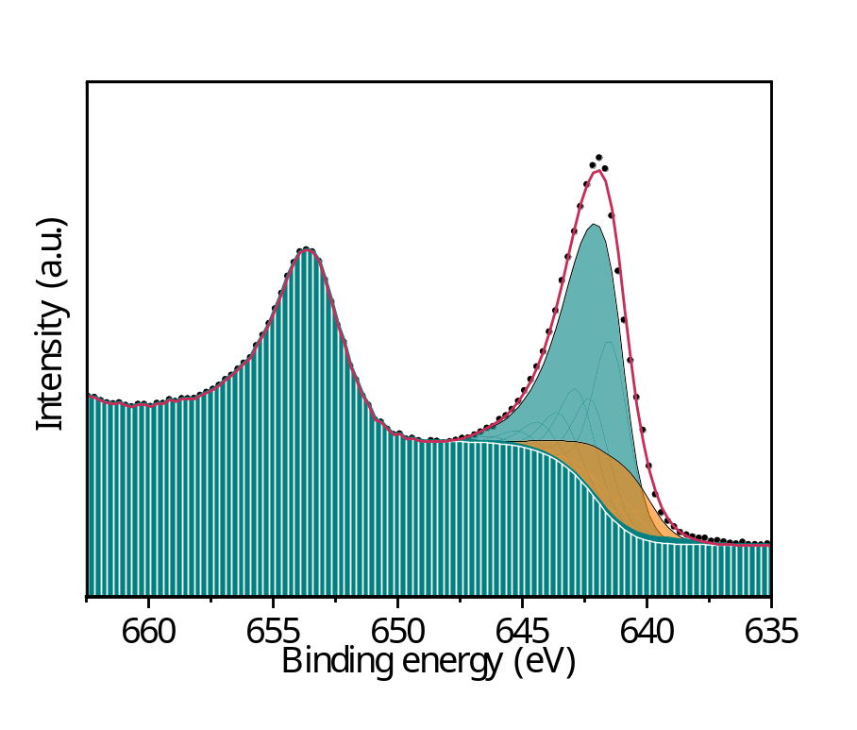
before_electrolysis
Mn2p_{3/2}
No | Name | Position (eV) | FWHM (eV) | Line shape | At%
1 | Mn⁴⁺-Peak 1 | 641.45 | 1.68 | GL(50) | 29.78
2 | Mn⁴⁺-Peak 2 | 642.19 | 1.68 | GL(50) | 15.9
3 | Mn⁴⁺-Peak 3 | 642.78 | 1.68 | GL(50) | 14.77
4 | Mn⁴⁺-Peak 4 | 643.48 | 1.68 | GL(50) | 8.25
5 | Mn⁴⁺-Peak 5 | 644.3 | 1.68 | GL(50) | 4.97
6 | Mn⁴⁺-Peak 6 | 645.17 | 1.68 | GL(50) | 2.59
7 | Mn⁴⁺-Peak 7 | 646.26 | 1.68 | GL(50) | 1.07
8 | Mn⁴⁺-Peak 8 | 646.48 | 1.68 | GL(50) | 0.39
9 | Mn³⁺-Peak 1 | 640.16 | 1.82 | GL(50) | 5.1
10 | Mn³⁺-Peak 2 | 640.95 | 1.82 | GL(50) | 5.13
11 | Mn³⁺-Peak 3 | 641.67 | 1.82 | GL(50) | 4.09
12 | Mn³⁺-Peak 4 | 642.38 | 1.82 | GL(50) | 3.17
13 | Mn³⁺-Peak 5 | 643.21 | 1.82 | GL(50) | 1.67
14 | Mn³⁺-Peak 6 | 644.09 | 1.82 | GL(50) | 0.9
15 | Mn³⁺-Peak 7 | 645.07 | 1.82 | GL(50) | 0.37
16 | Mn³⁺-Peak 8 | 638.31 | 1.82 | GL(50) | 0.18
17 | Mn²⁺-Peak 1 | 638.68 | 1.82 | GL(50) | 0.53
18 | Mn²⁺-Peak 2 | 639.72 | 1.82 | GL(30) | 0.37
19 | Mn²⁺-Peak 3 | 640.48 | 1.82 | GL(30) | 0.27
20 | Mn²⁺-Peak 4 | 641.36 | 1.82 | GL(30) | 0.19
21 | Mn²⁺-Peak 5 | 642.44 | 1.82 | GL(30) | 0.09
22 | Mn²⁺-Peak 6 | 643.53 | 1.82 | GL(30) | 0.04
23 | Mn²⁺-Peak 7 | 645.56 | 1.82 | GL(30) | 0.17
24 | Mn²⁺-Peak 8 | 637.03 | 1.82 | GL(30) | 0.02
M60%
77.72% Mn⁴⁺
20.61% Mn³⁺
1.68% Mn²⁺
The fitting parameters of the Mn2p3/2 spectra, such as the relative amounts of each oxidation state, were presented in right table. The spectra was calibrated using the C1s peak at 284.4 eV.

Slide 2
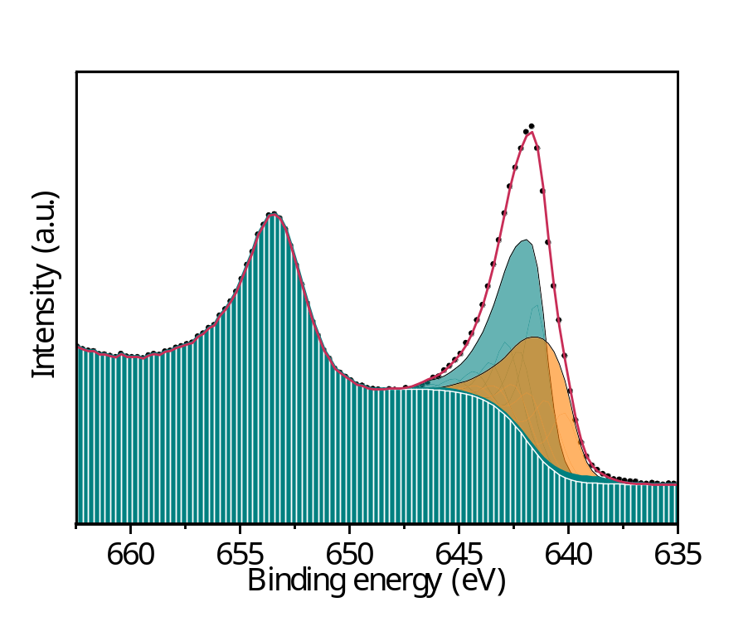
After Na
Mn2p_{3/2}
No | Name | Position (eV) | FWHM (eV) | Line shape | At%
1 | Mn⁴⁺-Peak 1 | 641.45 | 1.31 | GL(50) | 21.81
2 | Mn⁴⁺-Peak 2 | 642.19 | 1.31 | GL(50) | 11.64
3 | Mn⁴⁺-Peak 3 | 642.78 | 1.31 | GL(50) | 10.82
4 | Mn⁴⁺-Peak 4 | 643.48 | 1.31 | GL(50) | 6.04
5 | Mn⁴⁺-Peak 5 | 644.3 | 1.31 | GL(50) | 3.64
6 | Mn⁴⁺-Peak 6 | 645.17 | 1.31 | GL(50) | 1.9
7 | Mn⁴⁺-Peak 7 | 646.26 | 1.31 | GL(50) | 0.78
8 | Mn⁴⁺-Peak 8 | 646.48 | 1.31 | GL(50) | 0.28
9 | Mn³⁺-Peak 1 | 640.16 | 1.42 | GL(50) | 10.15
10 | Mn³⁺-Peak 2 | 640.95 | 1.42 | GL(50) | 10.2
11 | Mn³⁺-Peak 3 | 641.67 | 1.42 | GL(50) | 8.14
12 | Mn³⁺-Peak 4 | 642.38 | 1.42 | GL(50) | 6.31
13 | Mn³⁺-Peak 5 | 643.21 | 1.42 | GL(50) | 3.33
14 | Mn³⁺-Peak 6 | 644.09 | 1.42 | GL(50) | 1.79
15 | Mn³⁺-Peak 7 | 645.07 | 1.42 | GL(50) | 0.74
16 | Mn³⁺-Peak 8 | 638.31 | 1.42 | GL(50) | 0.37
17 | Mn²⁺-Peak 1 | 638.68 | 1.42 | GL(50) | 0.65
18 | Mn²⁺-Peak 2 | 639.72 | 1.42 | GL(30) | 0.46
19 | Mn²⁺-Peak 3 | 640.48 | 1.42 | GL(30) | 0.33
20 | Mn²⁺-Peak 4 | 641.36 | 1.42 | GL(30) | 0.23
21 | Mn²⁺-Peak 5 | 642.44 | 1.42 | GL(30) | 0.11
22 | Mn²⁺-Peak 6 | 643.53 | 1.42 | GL(30) | 0.05
23 | Mn²⁺-Peak 7 | 645.56 | 1.42 | GL(30) | 0.21
24 | Mn²⁺-Peak 8 | 637.03 | 1.42 | GL(30) | 0.03
M60%
56.91% Mn⁴⁺
41.03% Mn³⁺
2.07% Mn²⁺
The fitting parameters of the Mn2p3/2 spectra, such as the relative amounts of each oxidation state, were presented in right table. The spectra was calibrated using the C1s peak at 284.4 eV.

Slide 3
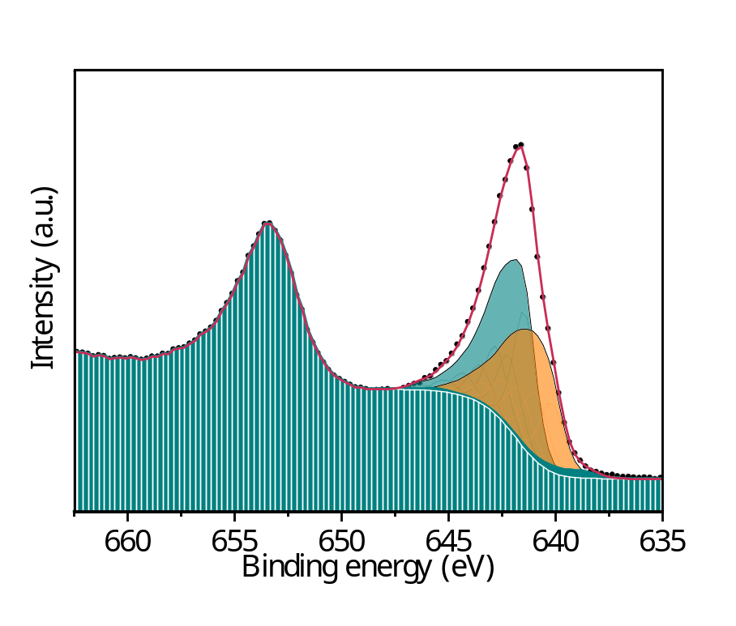
After K
Mn2p_{3/2}
No | Name | Position (eV) | FWHM (eV) | Line shape | At%
1 | Mn⁴⁺-Peak 1 | 641.45 | 1.25 | GL(50) | 20.23
2 | Mn⁴⁺-Peak 2 | 642.19 | 1.25 | GL(50) | 10.81
3 | Mn⁴⁺-Peak 3 | 642.78 | 1.25 | GL(50) | 10.04
4 | Mn⁴⁺-Peak 4 | 643.48 | 1.25 | GL(50) | 5.6
5 | Mn⁴⁺-Peak 5 | 644.3 | 1.25 | GL(50) | 3.38
6 | Mn⁴⁺-Peak 6 | 645.17 | 1.25 | GL(50) | 1.76
7 | Mn⁴⁺-Peak 7 | 646.26 | 1.25 | GL(50) | 0.73
8 | Mn⁴⁺-Peak 8 | 646.48 | 1.25 | GL(50) | 0.26
9 | Mn³⁺-Peak 1 | 640.16 | 1.35 | GL(50) | 10.99
10 | Mn³⁺-Peak 2 | 640.95 | 1.35 | GL(50) | 11.04
11 | Mn³⁺-Peak 3 | 641.67 | 1.35 | GL(50) | 8.81
12 | Mn³⁺-Peak 4 | 642.38 | 1.35 | GL(50) | 6.83
13 | Mn³⁺-Peak 5 | 643.21 | 1.35 | GL(50) | 3.6
14 | Mn³⁺-Peak 6 | 644.09 | 1.35 | GL(50) | 1.93
15 | Mn³⁺-Peak 7 | 645.07 | 1.35 | GL(50) | 0.81
16 | Mn³⁺-Peak 8 | 638.31 | 1.35 | GL(50) | 0.4
17 | Mn²⁺-Peak 1 | 638.68 | 1.35 | GL(50) | 0.88
18 | Mn²⁺-Peak 2 | 639.72 | 1.35 | GL(30) | 0.62
19 | Mn²⁺-Peak 3 | 640.48 | 1.35 | GL(30) | 0.44
20 | Mn²⁺-Peak 4 | 641.36 | 1.35 | GL(30) | 0.31
21 | Mn²⁺-Peak 5 | 642.44 | 1.35 | GL(30) | 0.14
22 | Mn²⁺-Peak 6 | 643.53 | 1.35 | GL(30) | 0.07
23 | Mn²⁺-Peak 7 | 645.56 | 1.35 | GL(30) | 0.28
24 | Mn²⁺-Peak 8 | 637.03 | 1.35 | GL(30) | 0.03
M60%
52.81% Mn⁴⁺
44.41% Mn³⁺
2.77% Mn²⁺
The fitting parameters of the Mn2p3/2 spectra, such as the relative amounts of each oxidation state, were presented in right table. The spectra was calibrated using the C1s peak at 284.4 eV.

